Slide 1




Small Organization Set Up in CISCO Packet Tracer
Team Bright Spark
Project By: Shikha Kumari, Roshni Verma, Srimona Maity
Guide By:
Ms. Arpita Roy Ma’am.

Slide 2
AGENDA
Problem statement
Project Overview
Solution and its value
End Users
Modelling
Wow Moment
Result

Slide 3
PROBLEM STATEMENT
A small organization with limited IT infrastructure and resources is facing challenges in setting up a functional network using Cisco Packet Tracer for presentation purposes. The organization aims to create an efficient and secure network simulation to illustrate key networking concepts, demonstrate troubleshooting scenarios, and enhance the understanding of network configurations among its staff.

Slide 4
PROJECT OVERVIEW
Our project is about Small Organization Set Up in CISCO Packet Tracer .

Slide 5

SOLUTION AND ITS VALUE PROPOSITION
Our proposed solution involves the comprehensive setup of Cisco Packet Tracer within the small organization to create a functional and educational network simulation for presentations. The solution addresses the identified challenges, providing a tailored approach to meet the organization's objectives. Here are the key components of the solution:
Expert Guidance and Training:
Customized Network Topology:
Security Implementation:

Slide 6
Who are the end user
The end users of a small organization that sets up Cisco Packet Tracer for presentations (PPT) can include various stakeholders within the organization. Here are the primary end users:
IT Staff:
Technical Training Participants:
Educational Trainers:

Slide 7
Technology
Networking
Software
CISCO Packet Tracer

Slide 8
Wow Moment
"wow" moment signifies the successful integration of Cisco Packet Tracer into the organization's educational and operational framework, showcasing the positive impact on staff knowledge, skills, and the overall network environment. It reinforces the organization's commitment to continuous learning and technological advancement.

Slide 9
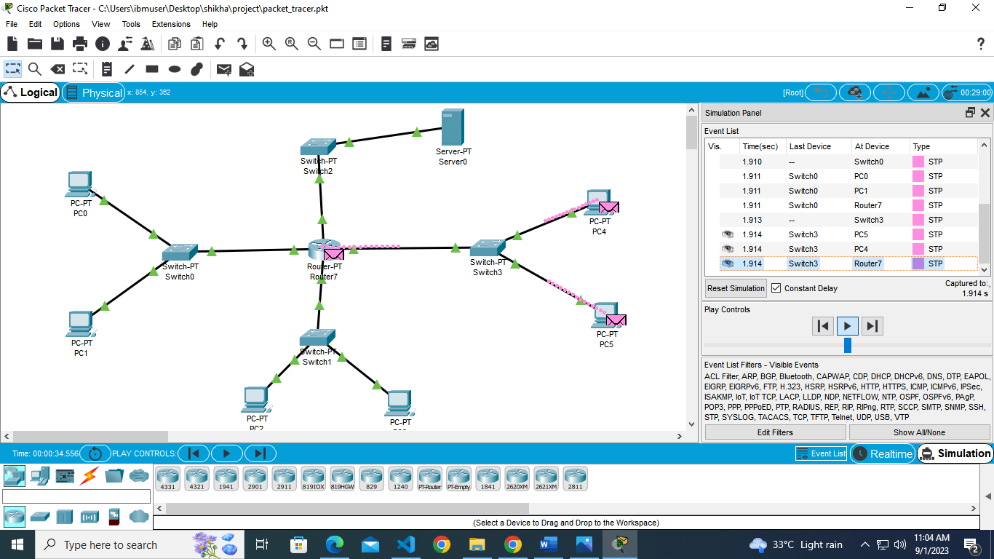
RESULTS

Slide 10
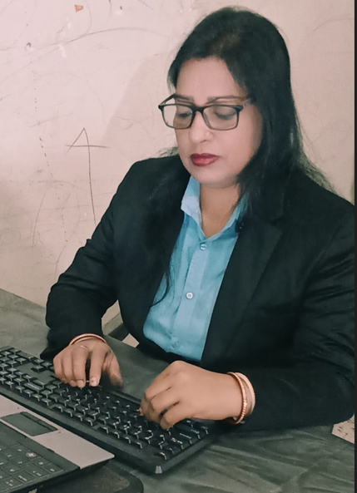
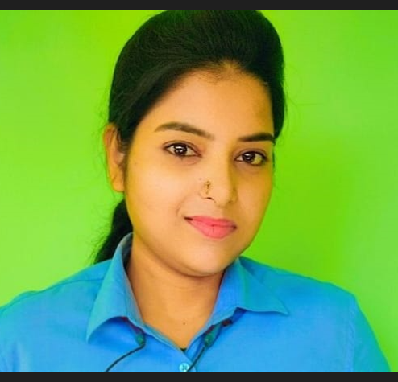
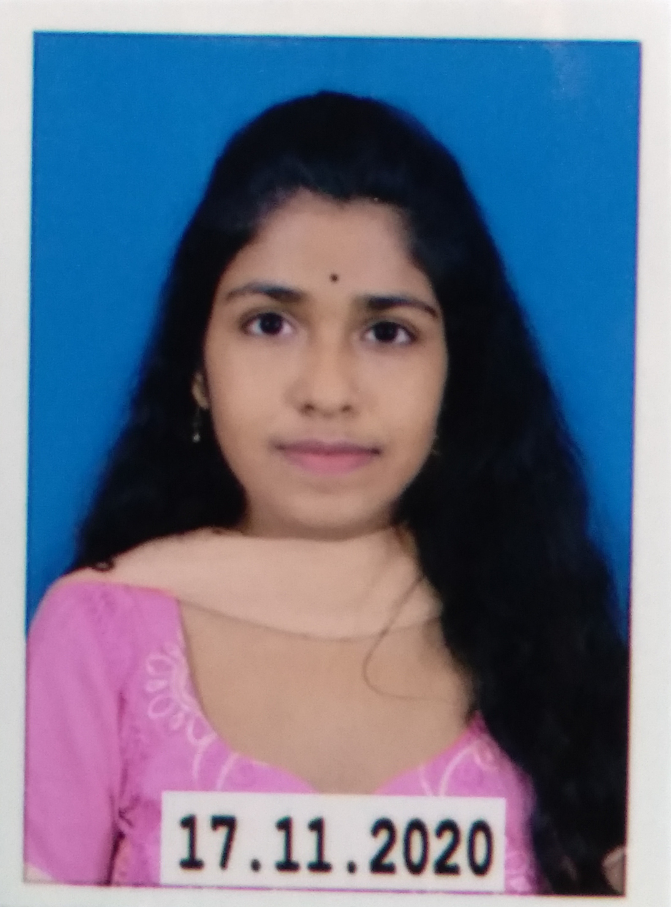
MEET OUR TEAM
Shikha Kumari
Roshni Verma
Srimana Maity

Slide 11

Thank you
This Photo by Unknown Author is licensed under CC BY-SA

